Slide 1
Advertising Sales Prediction Analysis
Identifying the Impact of Multi-Channel Marketing expenditure on Product Sales
DIVYAM
First Year Student at IIT Guwahati, CSE Department

Slide 2

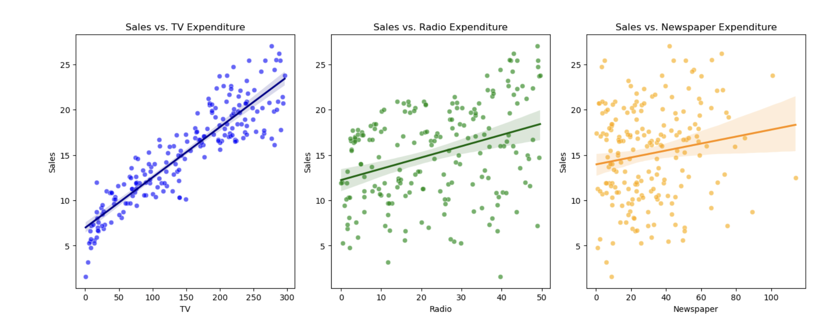
Data Preprocessing and Cleaning
Filled missing values in the Radio column by the median value.
All variables like TV, Radio, Newspaper, Sales checked for consistency and numerical formats for further modelling.

Slide 3
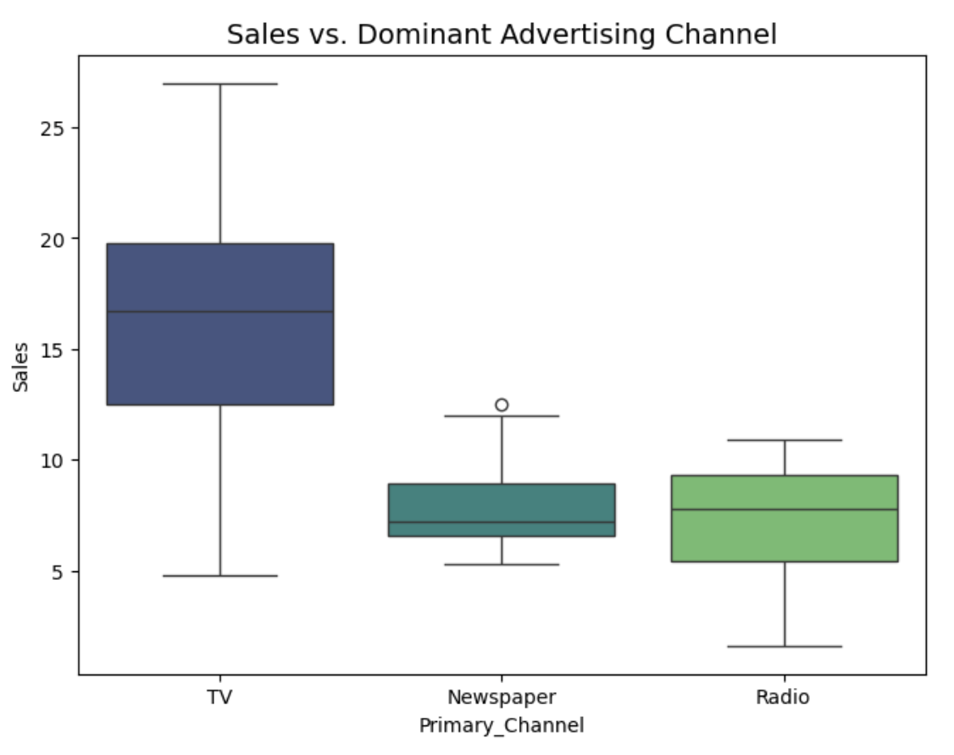
Expenditure Distribution
Radio: Distribution is relatively uniform.
TV: Distribution here also is more or less uniform.
Newspaper: Heavily skewed towards lower budget, most spent less than 50 on it.

Slide 4
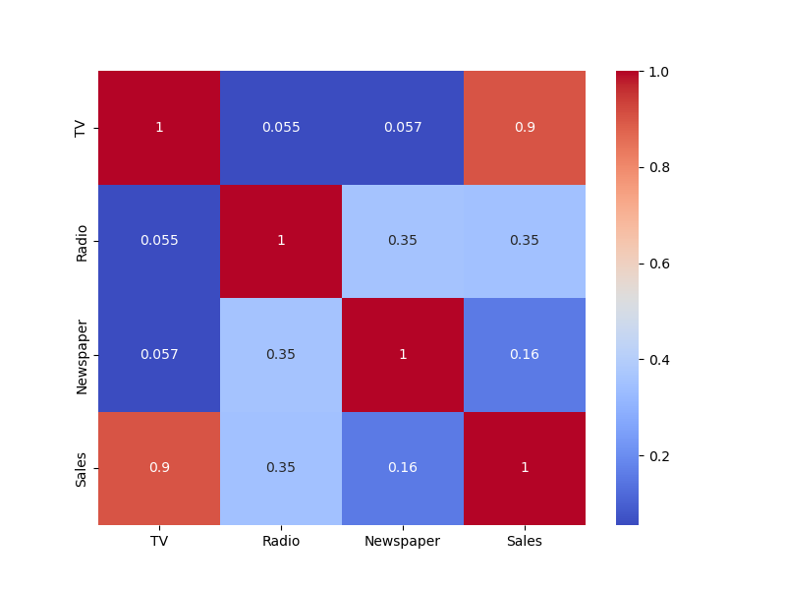
The TV Factor
There is quite strong correlation between TV and Sales (approximately 0.9).
Correlation between Radio and Sales is moderate (~0.35).
Newspaper and Sales have very weak correlation.

Slide 5
Visualising Linear Relationships
The scatter plot for TV spend vs Sales is most scattered around a positive slope line showing positive trend.
Newspaper Plots show significant noise implying it has weak correlation.

Slide 6
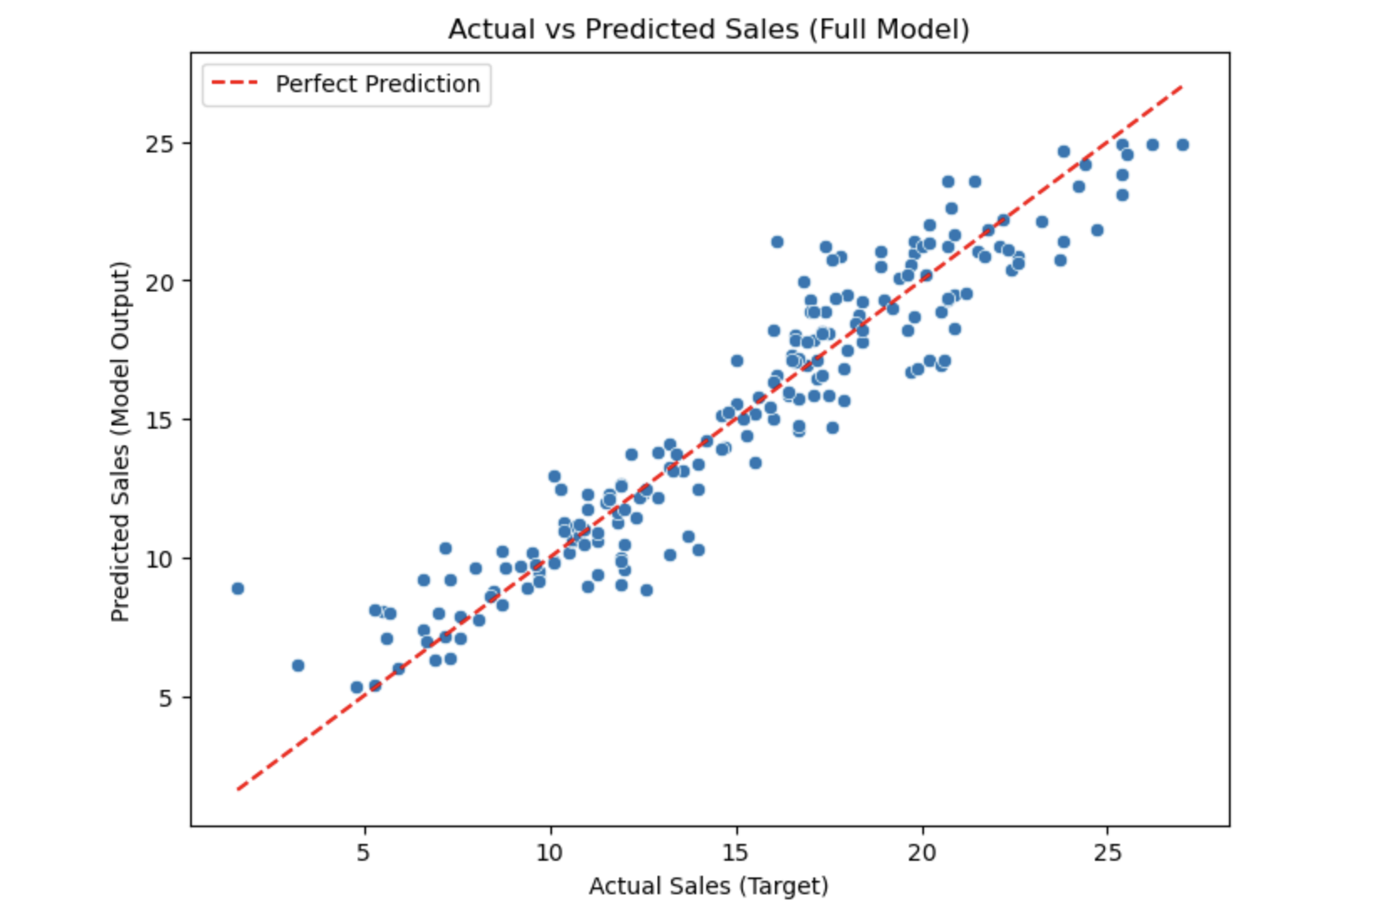
Predictive Model Performance
Model: Multiple Linear regression.
Accuracy (R^2): 0.903, this means our model can explain 90.3% variation in sales using just the three add channels.
Error (MSE): ~2, predictions are really close to the actual numbers.

Slide 7
Budget Scenario Prediction
Test Case: Expenditures: 200 on TV, 40 on radio, 50 on newspaper, Sales ??
Predicted result by our model: 19.81
It is largely driven by the expenditure on TV.

Slide 8
Recommendations
Prioritise TV Advertising.
Use radio as booster after TV.
Deprioritise Newspaper and rather spend them on TV.
Model can be safely used due to its high accuracy and low error.

